Slide 1

Mini Project (KCA353) Odd Semester Session 2024-25
PicStream
Presented By:
Rupesh Gupta: 2300290140150
Rohit Kumar : 2300290140148
Project Supervisor:
Dr. Vipin Kumar
Associate Professor

Slide 2
Content
Introduction (1 slide)
Literature Review (2 slides)
Objective of the Project (1 slide)
Technology
Hardware Requirements (Development Environment, Server requirement (if required), Client requirement (if required).
Software Requirements (Language and Platforms like Frameworks, VS code, Android Studio and Jupyter notebook etc. )
Modules (2-3 slides)
Workflow (1 slide)
Reports (For Example: Project : Student Monitoring System, so reports like: Student Marks, Subjects, companies visit, and student appears in placement etc.)
References (1 slide)
Notes:
Font Styles: Times New Roman + Font Size: 25

Slide 3
Introduction
An AI image generator is a powerful tool that uses artificial intelligence to create original images from text descriptions
Key Features:
Text to Image: You provide a description of the image you want, and the AI generates a unique visual based on your text.
Image Generation: These AI models are trained on massive datasets of images, enabling them to understand and recreate visual styles and concepts.
Creative Possibilities AI image generators unlock endless possibilities for creating stunning visuals for personal and professional projects
Notes:
Font Styles: Times New Roman + Font Size: 25

Slide 4
Literature Review
Previous Research
Numerous studies have explored stock market functionality, focusing on the impacts of technology on trading behaviour. For instance, Zhang et al. (2020) discuss how algorithmic trading has reshaped market dynamics by increasing liquidity but also contributing to volatility. Research by Kumar and Goyal (2019) emphasizes the importance of providing real-time data and analytics to empower investors, particularly in emerging markets.
Regarding IPOs, literature highlights the significance of investor sentiment and market conditions. Ibbotson and Jaffe (1975) found that IPOs often experience initial overpricing, a phenomenon that remains relevant in contemporary discussions. More recent analyses, such as those by Loughran and Ritter (2004), examine factors influencing IPO performance, including under-pricing and long-term returns.
Technological Advances
The rise of fintech has revolutionized stock trading and IPO management. Platforms such as Robinhood and E*TRADE have introduced mobile trading applications that cater to a younger demographic, as discussed by Lee and Wong (2021). These advancements not only democratize access to financial markets but also necessitate robust security measures to protect user data, as highlighted by Gupta (2022).
Notes:
Font Styles: Times New Roman + Font Size: 25

Slide 5
Literature Review (Contd.)
Market Trends
Recent trends indicate a significant shift towards retail investing, driven by social media and online trading platforms. The COVID-19 pandemic further accelerated this trend, as discussed by Barber and Odean (2020), leading to increased participation from individual investors. This shift presents both opportunities and challenges for platforms like BullRun, which must cater to a diverse user base.
Challenges and Limitations
Despite the advancements in trading platforms, challenges remain. Security vulnerabilities, market manipulation, and the psychological aspects of trading can impact user experiences. Research by Menkhoff et al. (2016) identifies behavioural biases that affect investor decisions, underscoring the need for educational resources to support informed trading.
Gaps in Research
While existing literature provides valuable insights into stock markets and IPO processes, there remains a gap in integrated platforms that combine trading and IPO functionalities. BullRun aims to address this gap by offering a comprehensive solution that enhances user engagement and investment strategies.
Notes:
Font Styles: Times New Roman + Font Size: 25

Slide 6
Objective of the Project
The primary objective of the BullRun project is to develop an integrated stock marketing and IPO management platform that enhances user accessibility and engagement in the financial markets.
Specifically, the objectives include:
Real-Time Stock Tracking: To provide users with up-to-date information on listed stocks, including prices and performance metrics, enabling informed investment decisions.
IPO Participation: To facilitate seamless access to upcoming IPOs, allowing users to easily subscribe and manage their applications.
Portfolio Management: To offer robust tools for users to monitor and manage their investment portfolios, displaying detailed information on stock quantities and values.
User Experience Enhancement: To design a user-friendly interface that caters to both novice and experienced investors, promoting efficient navigation and decision-making.
Notes:
Font Styles: Times New Roman + Font Size: 25

Slide 7
Technology (Hardware Requirements)
Processor: Any processer with 2.4 Ghz processing speed or more
Hard Disk: 50 GB or above
RAM: 512 MB or above
Notes:
Font Styles: Times New Roman + Font Size: 25

Slide 8
Technology (Software Requirements)
Visual Studio Code
Windows 10 and above
Language: HTML and CSS
Framework: React, Nodejs, Expressjs
Database: MongoDb
Notes:
Font Styles: Times New Roman + Font Size: 25

Slide 9
Modules
Notes:
Font Styles: Times New Roman + Font Size: 25

Slide 10
Modules (Contd.)
Notes:
Font Styles: Times New Roman + Font Size: 25

Slide 11
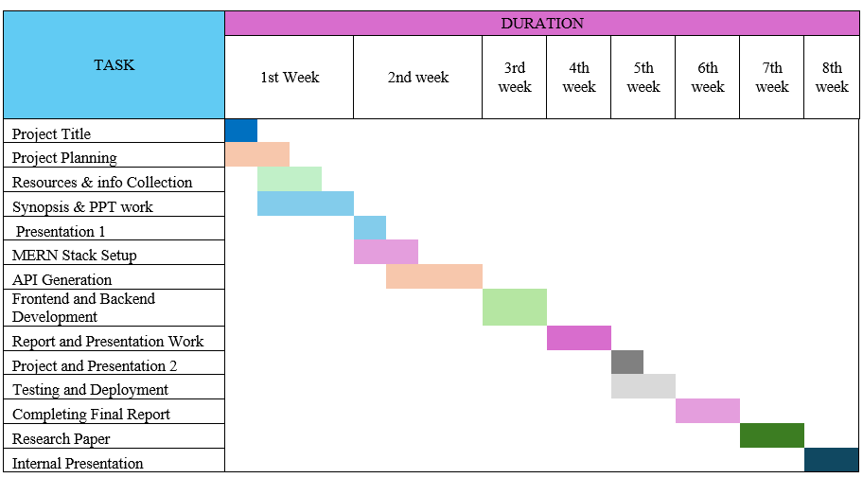
Workflow/Gantt Chart
Notes:
Font Styles: Times New Roman + Font Size: 25

Slide 12
Reports
Notes:
Font Styles: Times New Roman + Font Size: 25

Slide 13
References
JavaScript Mastery
MDN
Notes:
Font Styles: Times New Roman + Font Size: 25

